Slide 1
Lesson objective
Need whiteboards.
Title: Question break down
Aim:
Identify key information to solve worded questions.
Develop written strategies to add and subtract negative numbers.
Plan:
Daily review
Key details
Alternative negatives

Slide 2
Daily review
Rounding
Identify place value, look to the right. If the number is 5 or more round up. 4 or less, leave it the same.
E.g., Round 1798 to the nearest hundred
E.g., 2. Roung 12.564 to the nearest hundredths

Slide 3
Exercise books
Round these to the nearest 100
Round to the nearest TENTHS
456
12 450
1991
89
2.432
4.689
11. 123
150.187

Slide 4
Breaking down a question
Underline the important information
Understand what the question is asking of me
Identify what mathematical process I will use
Write my answer and statement if required
Check my answer makes sense

Slide 5
Numbers and time
Mr. Davies just bought some chicken from the shop and wants to freeze it when he gets home. The chicken comes out of the fridge at 8°C and, after 4 hours it is now frozen at -4°C. How many degrees per hour does the temperature of the chicken drop?

Slide 6
Worded questions continued
John works in a very tall building that is 22 stories tall. It also has 5 levels below ground which are under ground parking
John parks his car on 2nd story below ground floor. He then goes up 5 levels, down 2 levels, up 11 levels and then down 10 levels. Which floor is John on?

Slide 7

Try on your own
Sally is recording temperatures during the day. When she started, the temperature was $−5℃$. It then got warmer by $22℃$. Later it increase again by $3℃.$The last time Sally checked; the temperature had dropped by $30℃.$ What was the temperature on Sally’s last recording?

Slide 8
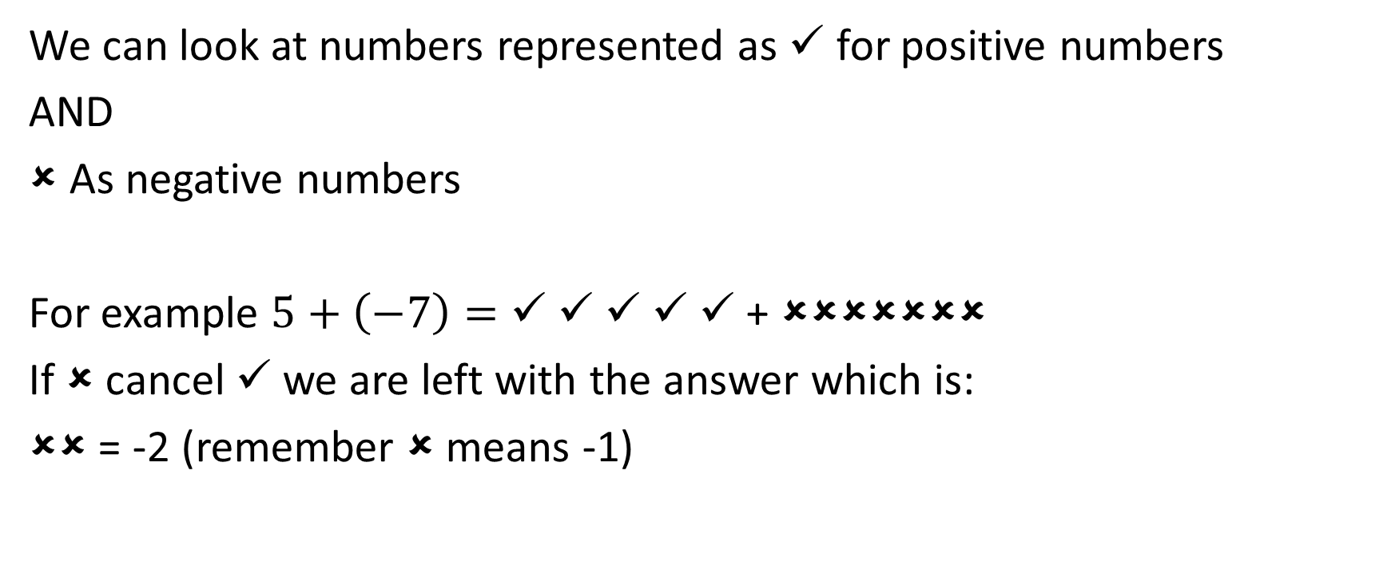
Ticks and crosses
We can look at numbers represented as ✓ for positive numbers
AND
As negative numbers
For example $5+\left(−7\right)=$ ✓ ✓ ✓ ✓ ✓ + ✗✗✗✗✗✗✗
If ✗ cancel ✓ we are left with the answer which is:
✗✗ = -2 (remember ✗ means -1)

Slide 9
Examples
7 + (-5) =
-5 + - 6 =
-3 + 8 =

Slide 10
Whiteboards
Convert the question to ticks and crosses, then change to numbers for your answer.
15 + -7 =
8 + - 11 =
-8 + - 6 =
12 + 5 =

Slide 11
Individual practice
Using ticks and crosses as working out solve:
4 + (-5) =
12 + (-8) =
(-9) + (-5) =
(-3) + (-7) =
(-15) + 12 =
9 + (-20) =
Use your understanding to answer these:
130 + (-20) =
(-200) + (-21) =
90 + (-22) =
145 + (-200) =

Slide 12
Conclusion
When adding integers with the same sign, we can add the numbers together and keep the same sign.
When adding integers with different signs, we take the numbers and keep the sign for the “big” number.
E.g.,
18 + (-9) =
9 + (-18) =
(-10) + (-5) =
(-200) + (-45) =

Slide 13
Reflection
Aim:
Identify key information to solve worded questions.
Develop written strategies to add and subtract negative numbers.

